Slide 1


Same basic thoughts on Classical and Bayesian Inference
Peter Jan van Leeuwen

Slide 2



How do we process new data?
♬

Slide 3
A process description
Prior knowledge, from you model of the world, a cat
Observation, the dog
Posterior knowledge, improvement of the model, the dog that has eaten the cat

Slide 4
The human learning cycle
We have a view of the world, the prior
New observations come in, the likelihood
We combine the two, and form the posterior
The posterior is our new prior
New observations come in, the likelihood
We combine the two, and form the posterior
Etc.

Slide 5
Example
Is there a trend?

Slide 6

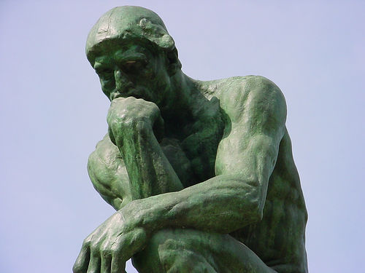

Is there a trend?
Trend ?
YES !

Slide 7
Questions…
How certain is this result?
How robust is it?
How did the machine come to this answer?
I have other indications that tell me there is no trend, how do I take these into account?
Am I happy with a yes/no answer (am I a politician) ?
How would I like the machine to come to an answer?

Slide 8
Science 101
We want to infer something about the trend
And we want to use the observations (or model results) as basis.
Formally, we want to infer about the trend given the observations.
We want to reflect that observations have uncertainties, so our inference will also be uncertain.
One way to quantify this uncertainty is via a probability
Doing that we find that we want to know
trend means size of the trend

Slide 9
How do we calculate this probability?
Use Bayes Theorem:
We need to evaluate this equation for each possible value of the trend.
Likelihood
Prior

Slide 10
The likelihood .
This is simple (in principle), just the observation errors!
Often observation errors are Gaussian, i.e.
We need for each value of
Each of these values is given, so it acts as Nature, so we find

Slide 11
The prior .
If you know something about the trend from other sources, e.g. a best value and its uncertainty, than that defines the prior
If you don’t know anything … that never happens
Flat prior, Jeffrey’s prior, symmetry arguments,…
The point is that you have to say explicitly what your prior is.
That way it becomes science because now we can debate about it !

Slide 12
So the machine should calculate
This is the full answer, a pdf of the trend given the observations
No yes/no
No hypothesis
No difficult thinking

Slide 13
That’s all folks!

Slide 14

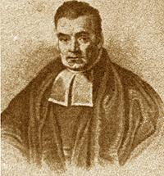
And what about significance testing???

Slide 15
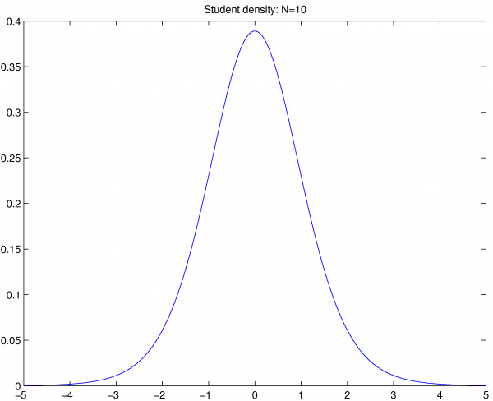
What is significance testing?
We are taught to infer the truth of the hypothesis H₀ that the trend is zero :
Find a test statistic T with known distribution that can be computed from measurements.
We need a hypothetical
distribution generated from
an infinite number of
observation sets …
Lets assume T is Student’s t

Slide 16
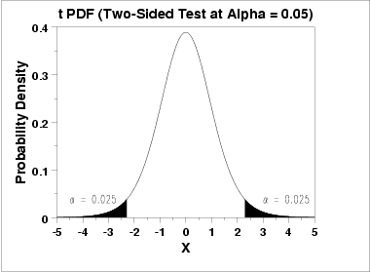
What is significance testing?
Define a significance level α, as the probability threshold above which H₀ will be rejected:
Let’s use … α =0.05
Find the region for T for which H is rejected,
so solve for R_{reject} in
Determine if p=T_{obs} falls in that
region, so if p is in R_{reject}
If it does H₀ is rejected, if not,
H₀ is not rejected.
p-value

Slide 17
What is significant testing?
Luckily we didn’t
Fail to reject the null hypothesis
That would be a triple negative…
Who invented this jargon???

Slide 18
A few questions…
How do we find the distribution of T?
What should we choose for α? That seems to depend mainly on what others in the field have done, so α=0.05… (where is the science?)
Is a yes/no answer useful?
…

Slide 19
The full critics… 1
1) We want to know:
What is the probability of different trends given the observations.
Statisticians force us to ask questions in term so hypothesis, so how likely is the hypothesis given the observations,
Is that really what we want to know???
2) However, the test they invert works with
, so the ‘inverse’.
And these are REALLY different…

Slide 20
What is wrong with the following reasoning? (Read Maarten Ambaum, J Climate, 2010)
My trend estimate stands out from the noise.
So my trend estimate is not likely to be caused by noise.
It is therefore unlikely that what I am seeing is noise.
The trend estimate is therefore positive evidence that there is really something happening.
This provides evidence for my theory.
2) Pr (I observe something | My system just produces noise) is low
3) Pr (My system just produces noise | I observe something ) is low
These are different. We want 3), but significant testing provides 2).

Slide 21
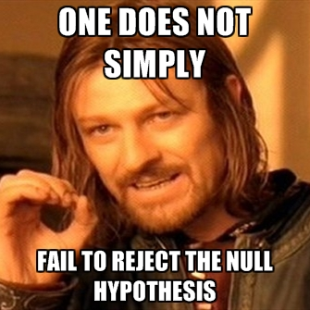
The full critics… 2
3) The hypothesis is always false, as the trend is never exactly zero! So unlike the original
problem statement suggests, the truth
of the hypothesis is not tested.
4) The true/false dichotomy is about decision making, not about science. What if the observations are close to the edge of the decision region?

Slide 22
The full critics 3
5) It doesn’t tell is about the size of the effect, only yes or no.
6) The word ‘significant’ is misused, it should mean how big the effect is and if it can be replicated. Not so here…
7) It is widely misunderstood. It does not tell us if a hypothesis is true, it doesn’t tell how likely the hypothesis is, etc etc.
8) It doesn’t use any prior information, so no systematic scientific progress. (Also, results often need to be tempered after the fact by prior knowledge…)

Slide 23
The full critics 4
9) It is open to easy abuse by selection. Statistically, too many
articles present significant results, leading to a bias. If not
statistically significant it is harder to publish a result.
10) Only one hypothesis can be H₀, so the test is asymmetric.
11) It puts strong restrictions on sample size. A number of small
sample-size studies might tell us more than one large study, but
none of them will pass a significant test individually.
12) It emphasis random errors in large samples, instead of errors
in individual measurements, so these errors tend to be ignored,
while we should address them.

Slide 24
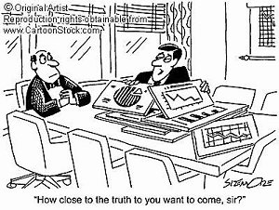
The full critics 5
13) It requires a number of unjustified assumptions: the distribution
of the test statistic, sampling has to be purely random, α-value
highly sensitive to scale transformations.
14) The results of two studies cannot be compared as random
differences become highly amplified.
15) It is easy to play dirty, so choose
the α-value after finding the p-value
such that your result is significant…

Slide 25
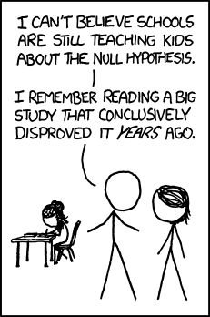
The full critics 6
16) Fisher himself didn’t see it as a good test, but simply as a
quick and dirty first check to see if further research was necessary…
So this way of hypothesis testing just
doesn’t work for real science…

Slide 26
Conclusions
As scientists we are interested the probability of the trend given a set of observations
We know how to calculate that
It is a learning framework, so new observations can easily be taken into account
Statistical significance testing:
gives the wrong answer to the wrong question
is hopelessly complicated

Slide 27
So there is work to do:
Never use significance testing again !
Reject papers that use it !
Remove it from the curriculums !

Slide 28
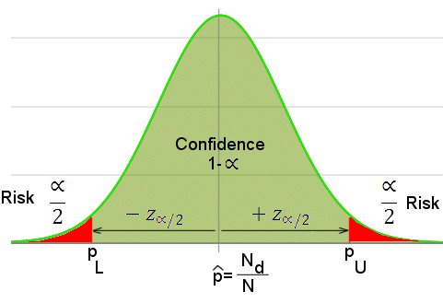
And confidence intervals?
Determine the distribution of a test statistic T, e.g T is the (normalised) difference in the mean, so Student’s t distributed.
Set α and define a confidence interval Pr(-c(α) < T < c(α)) = 1-α,
Do the experiment and calculate the boundaries of the interval from the experimental mean and variance, around the mean.
This is often interpreted as:
There is a change of (1-α)
that the true mean lies in
this interval.

Slide 29
Confidence intervals???????
However, that is an incorrect interpretation. The correct frequentist interpretation is:
After numerous identical experiments 95% of the calculated confidence intervals will contain the true parameter value.
Each interval in isolation has a 0% or a 100% probability of containing the true parameter value…
Is this useful???

